Slide 1
Models: Keeping the Horse before the Cart
Presented at the 2015 ACEC-KY/FHWA/KYTC Partnering Conference
Tom Creasey, PE, PhD
September 9, 2015

Slide 2
“If all you have is a hammer, everything looks like a nail.”
Paraphrased from
The Psychology of Science
Abraham Maslow, 1966

Slide 3
We make multi-million-dollar investment decisions based on the answers we get from models, but how do we know if the answers are right? And are we answering the right questions?

Slide 4
Levels of Analysis
High Level
Sketch Planning
Areawide
Multi-Facility
Deterministic Analysis
Medium Level
Single Facilities
Corridors
Segments
Points
Accuracy
Microscopic Simulation
Low Level
Direct Field Measurement
Resources
Required
Precision
of Estimate
Source: NCHRP 7-22, Planning and Preliminary Engineering Applications Guide to the HCM

Slide 5
Model Categories
Sketch Planning Tools
Travel Demand Models
Analytical/Deterministic Models
Traffic Signal Timing/Optimization Models
Traffic Simulation Models
Integrated Traffic Analysis Tools

Slide 6
Model Categories and the Project Development Spectrum
Preservation
Maintenance
Reliability
Performance Monitoring
Planning
Preliminary
Engineering
Design
Construction
(Traffic Control)
Operations
Analytical/Deterministic Tools
Travel
Demand
Models
Traffic Simulation Models
Performance Monitoring
Reliability
Traffic
Signal
Timing
Sketch
Planning
Tools
Where do you fit in?
How good is your understanding of the tools
available in your area?

Slide 7
Model Definition
$$E=mc^{2}$$
A system of postulates, data, and inferences presented as a mathematical description of an entity or state of affairs; also: a computer simulation based on such a system (Merriam-Webster Dictionary)
Software
Automation of the model for the sake of efficiency, accuracy and productivity

Slide 8
Basic Model Types
Deterministic
Stochastic

Slide 9
Deterministic (i.e. Analytical) Models
No randomness
Always produces same output from given starting condition or initial state (inputs)
Examples
HCM
aaSIDRA
Synchro ICU

Slide 10
Stochastic Models
Having random probability distribution that may be analyzed statistically but not predicted precisely
Statistically – mean, standard deviation, confidence intervals, etc.
Typically implemented through simulation

Slide 11
Simulation Models
Macroscopic – based on speed/flow/density deterministic relationships
Mesoscopic
Microscopic
Incorporates randomness
“Particle”-based
Behavioral “rules” (i.e. models) for car following, lane changing, gap acceptance, etc.

Slide 12
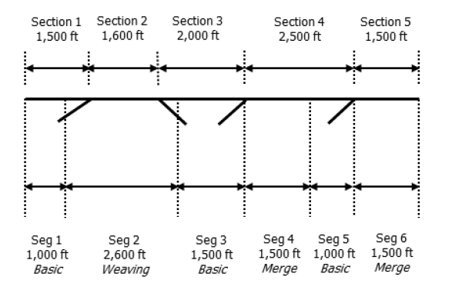
We’re not confined to simulation anymore for:
Arterials/Urban Streets
Interchange Ramp Terminals/Alternative Intersections
Freeway Facilities

Slide 13
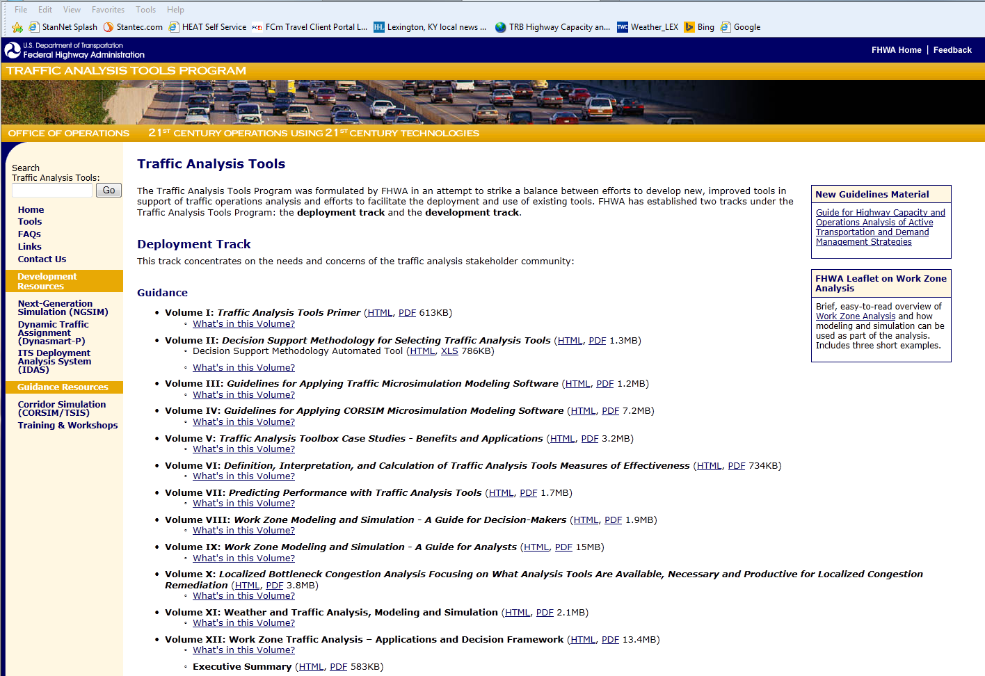
FHWA Traffic Analysis Tools
http://www.ops.fhwa.dot.gov/trafficanalysistools

Slide 15
Two Areas Where the Industry is Headed
Simplification – HCM Planning & Preliminary Engineering Applications Guide
MAP-21 Performance Measures – especially reliability (SHRP 2 research)

Slide 16
The Bottom Line
Know your project needs
Know your tools (models)
What they can do
What they can’t do
What it will take (time, effort) to use them
What you expect to get from them
Select the most appropriate tool for the job

Slide 17
You wouldn’t buy a car based only on the color. Why would you make a much more costly infrastructure decision based simply on how software looks?

Slide 18
Questions?

